Slide 1

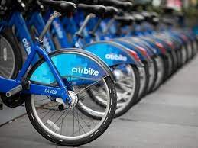
Capstone Project
Topic: NYCiti bike analysis

Slide 2
Introduction:
Dataset is available at:
https://www.kaggle.com/datasets/sujan97/citibike-system-data
Project objective:
Preliminary analysis to understand our data
Clean the data & apply analytical techniques using python
Pick the appropriate features for our visualization
Formulate problem statements for analysis & create visuals on Tableau to get essential insights

Slide 3
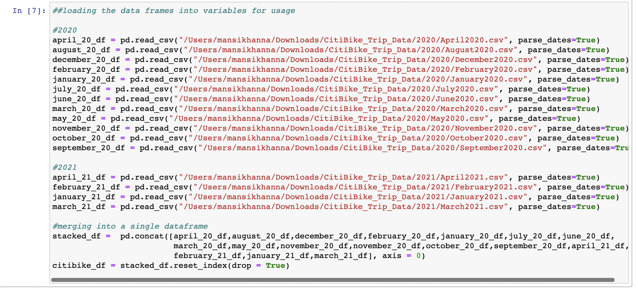
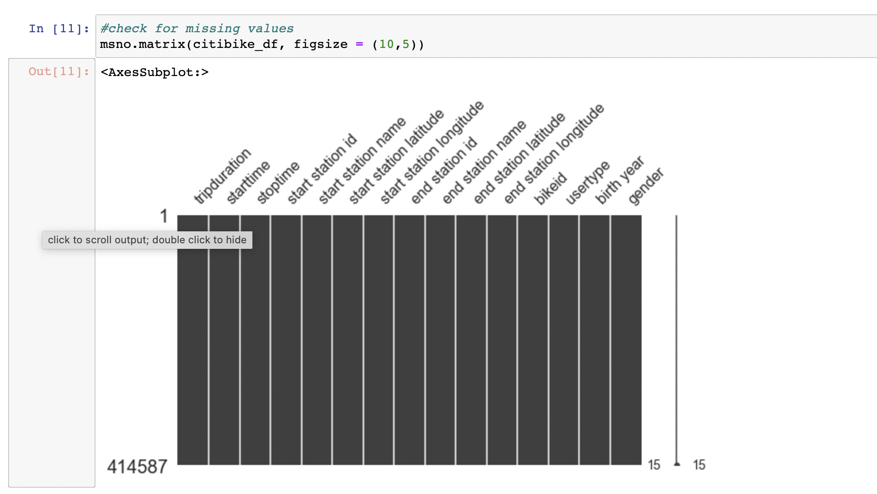
Data description using Python:

Slide 4
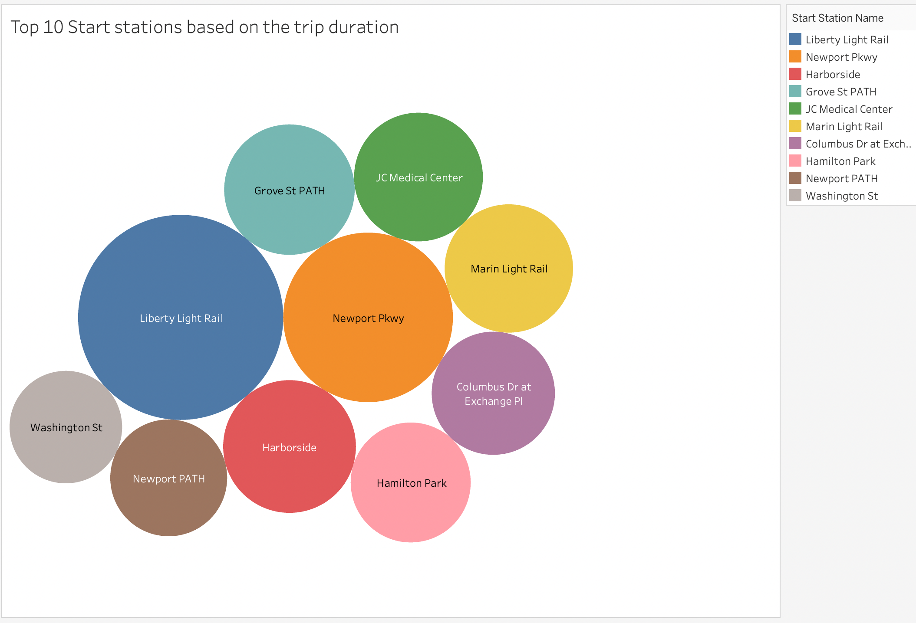
Visualisations:

Slide 5
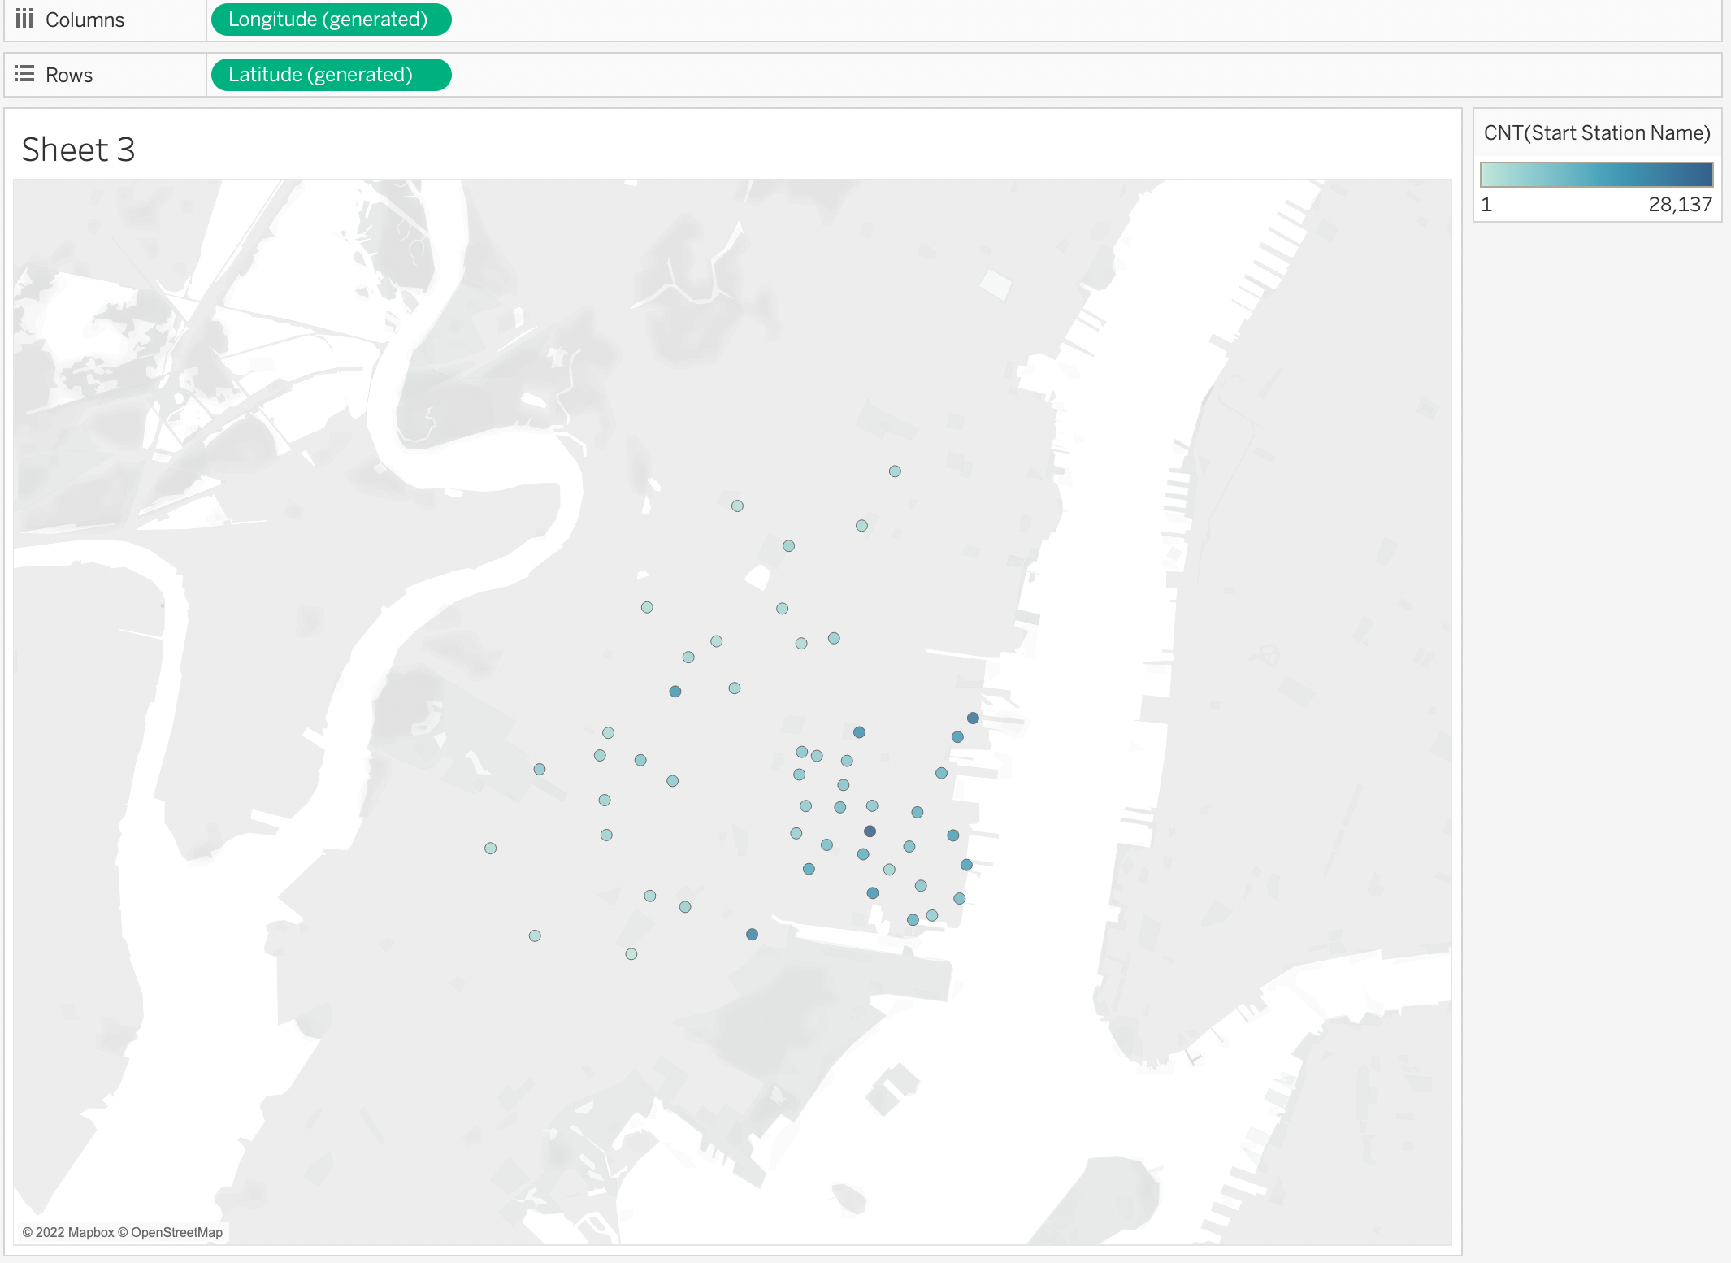

Slide 6
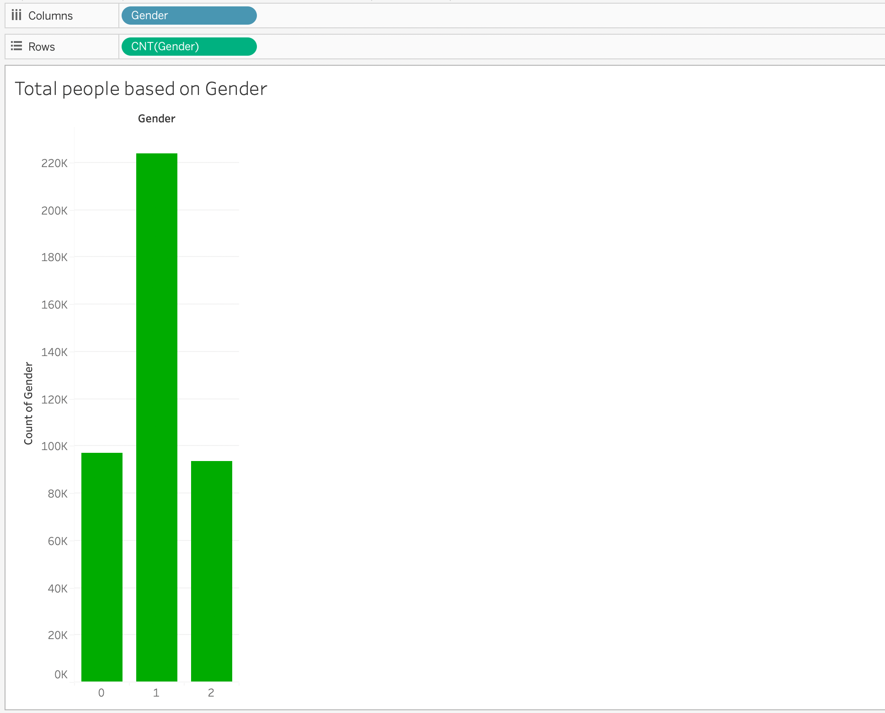

Slide 7
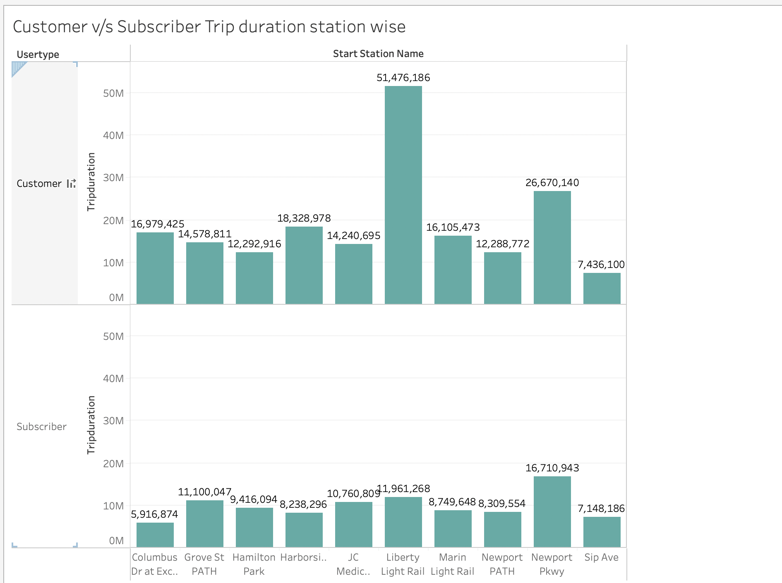

Slide 8
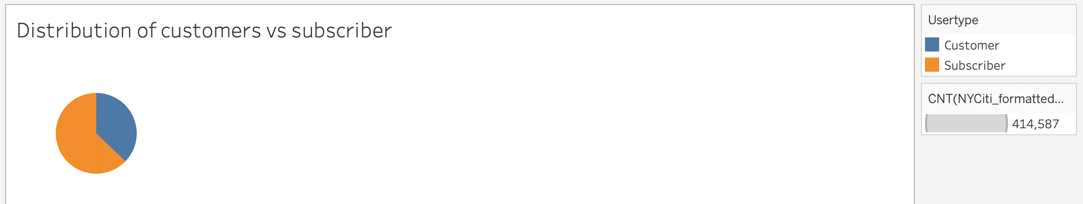

Slide 9
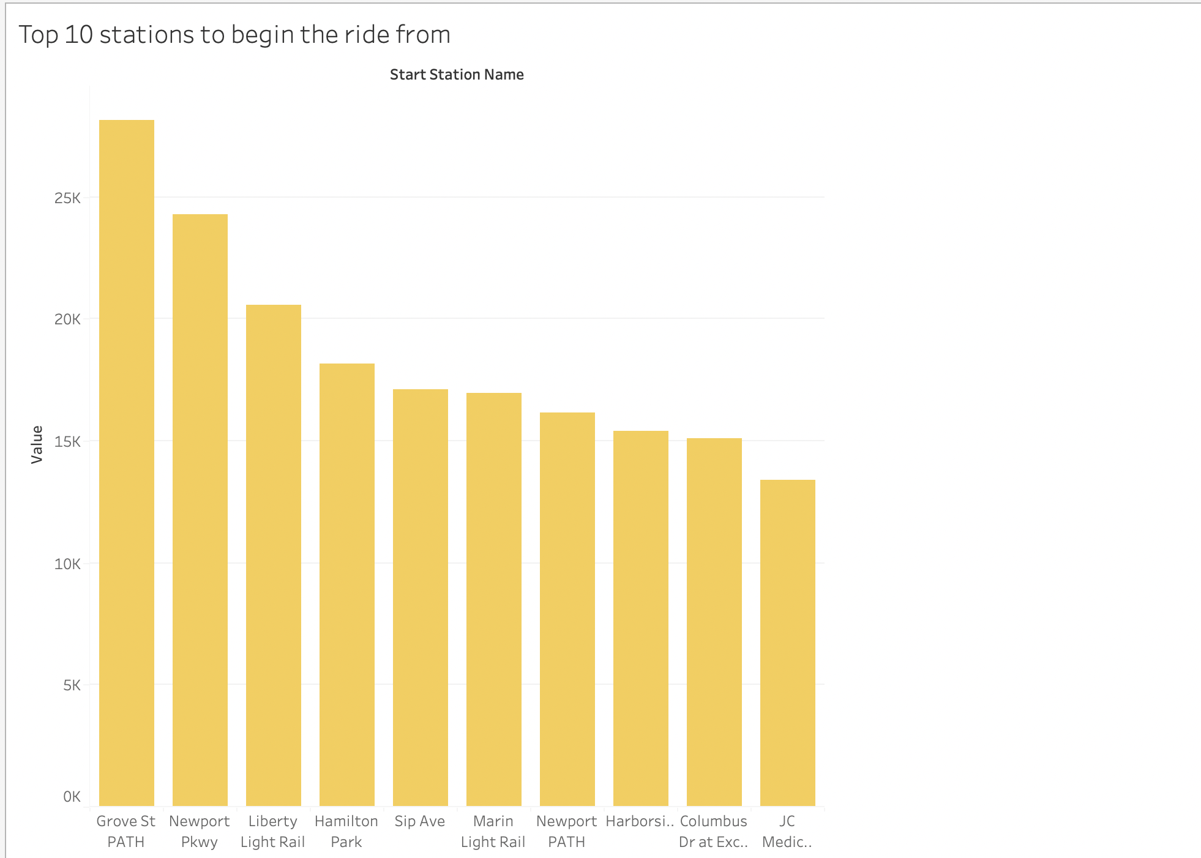

Slide 10
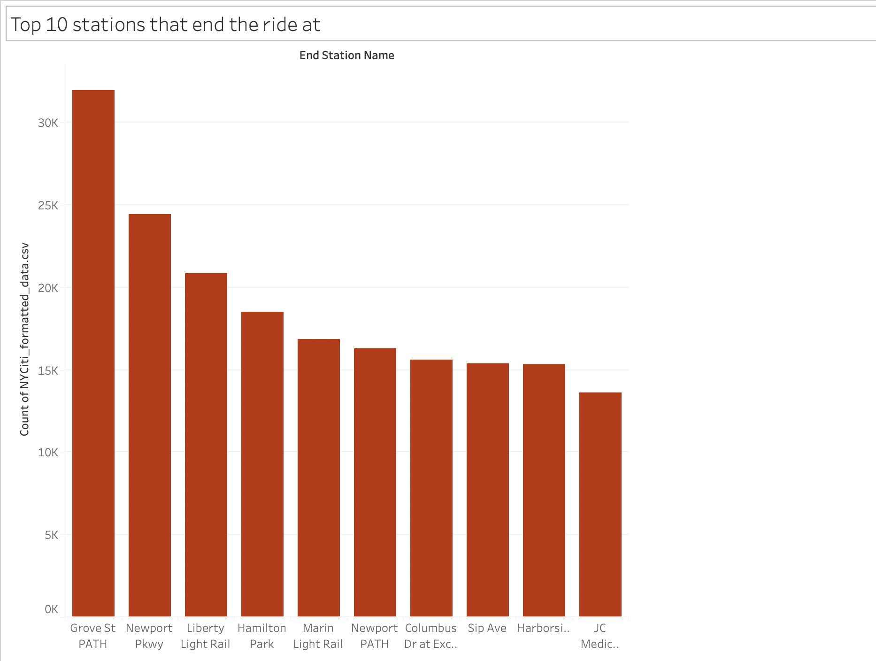

Slide 11
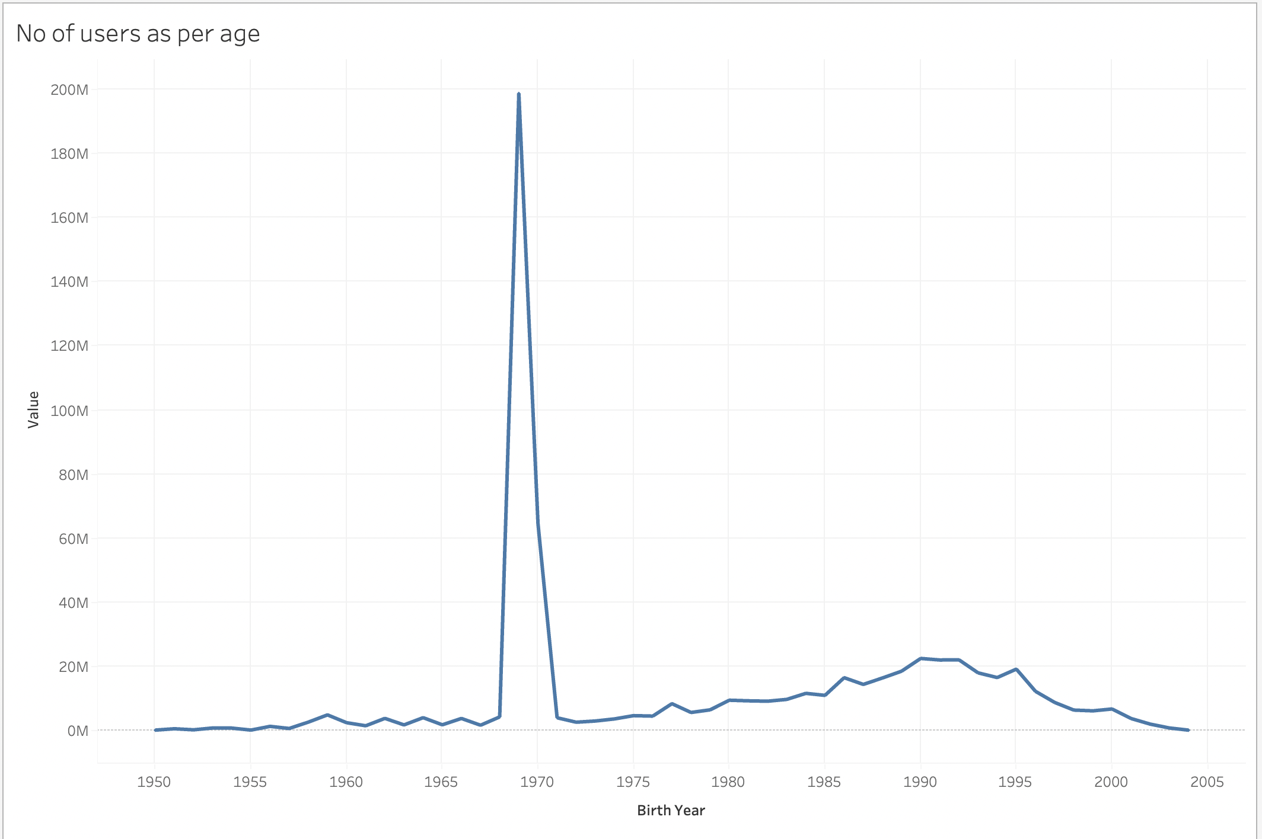

Slide 12
Key learnings through this project:
Apt data cleaning & EDA gives clarity
Choosing the right charts helps give clear insights
Getting hands-on exposure to Tableau’s advanced techniques like calculated fields, joins, unions, parameters, dashboards & storyboards helps in analyzing the data even better
Understanding holistically how Tableau can be such a crucial tool to understand the macro as well as micro facets of a business.

